Slide 1
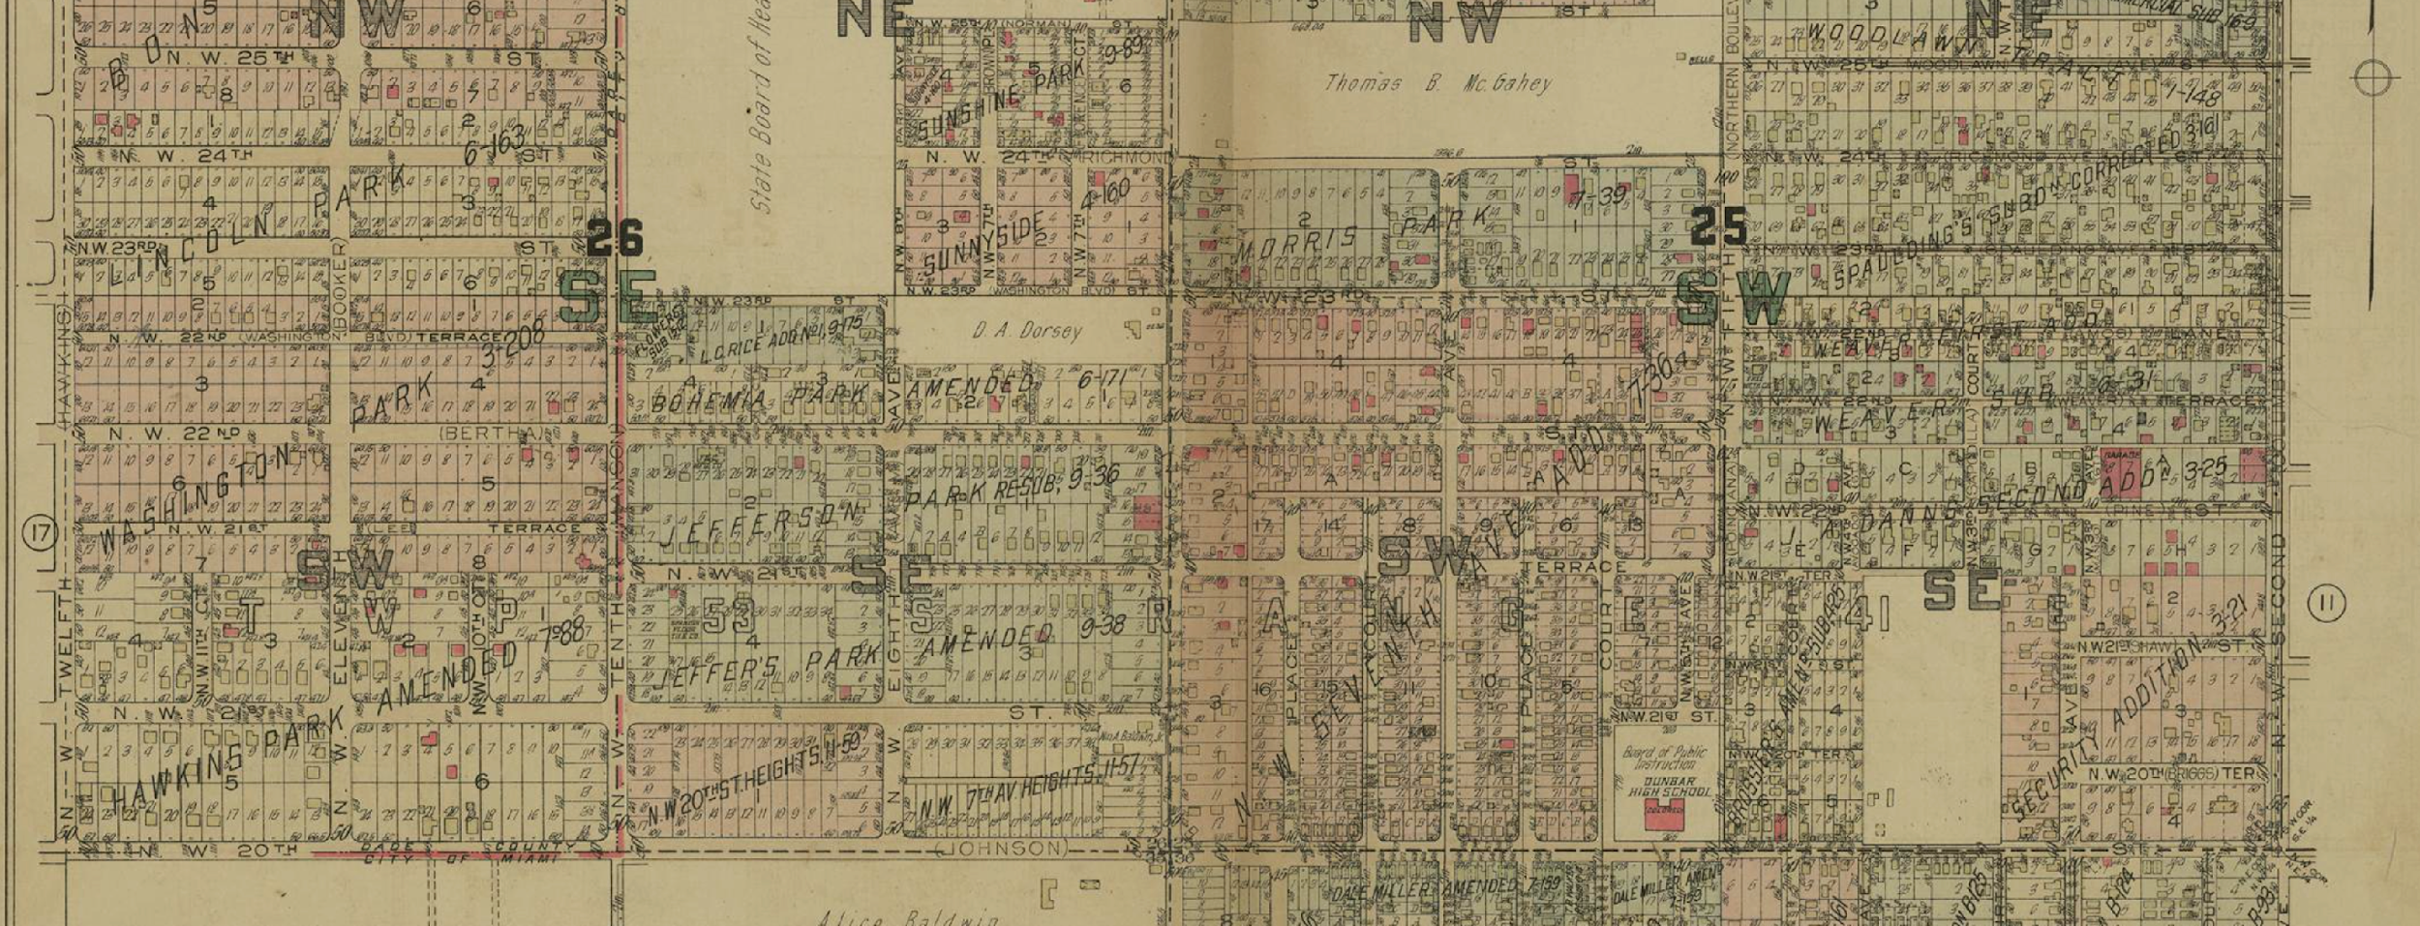
Ethical Data Considerations for Engaging in Reparative Archival Practice
A Case Study - Dana A. Dorsey Papers
Rhia Rae
Jamie Rogers

Slide 2
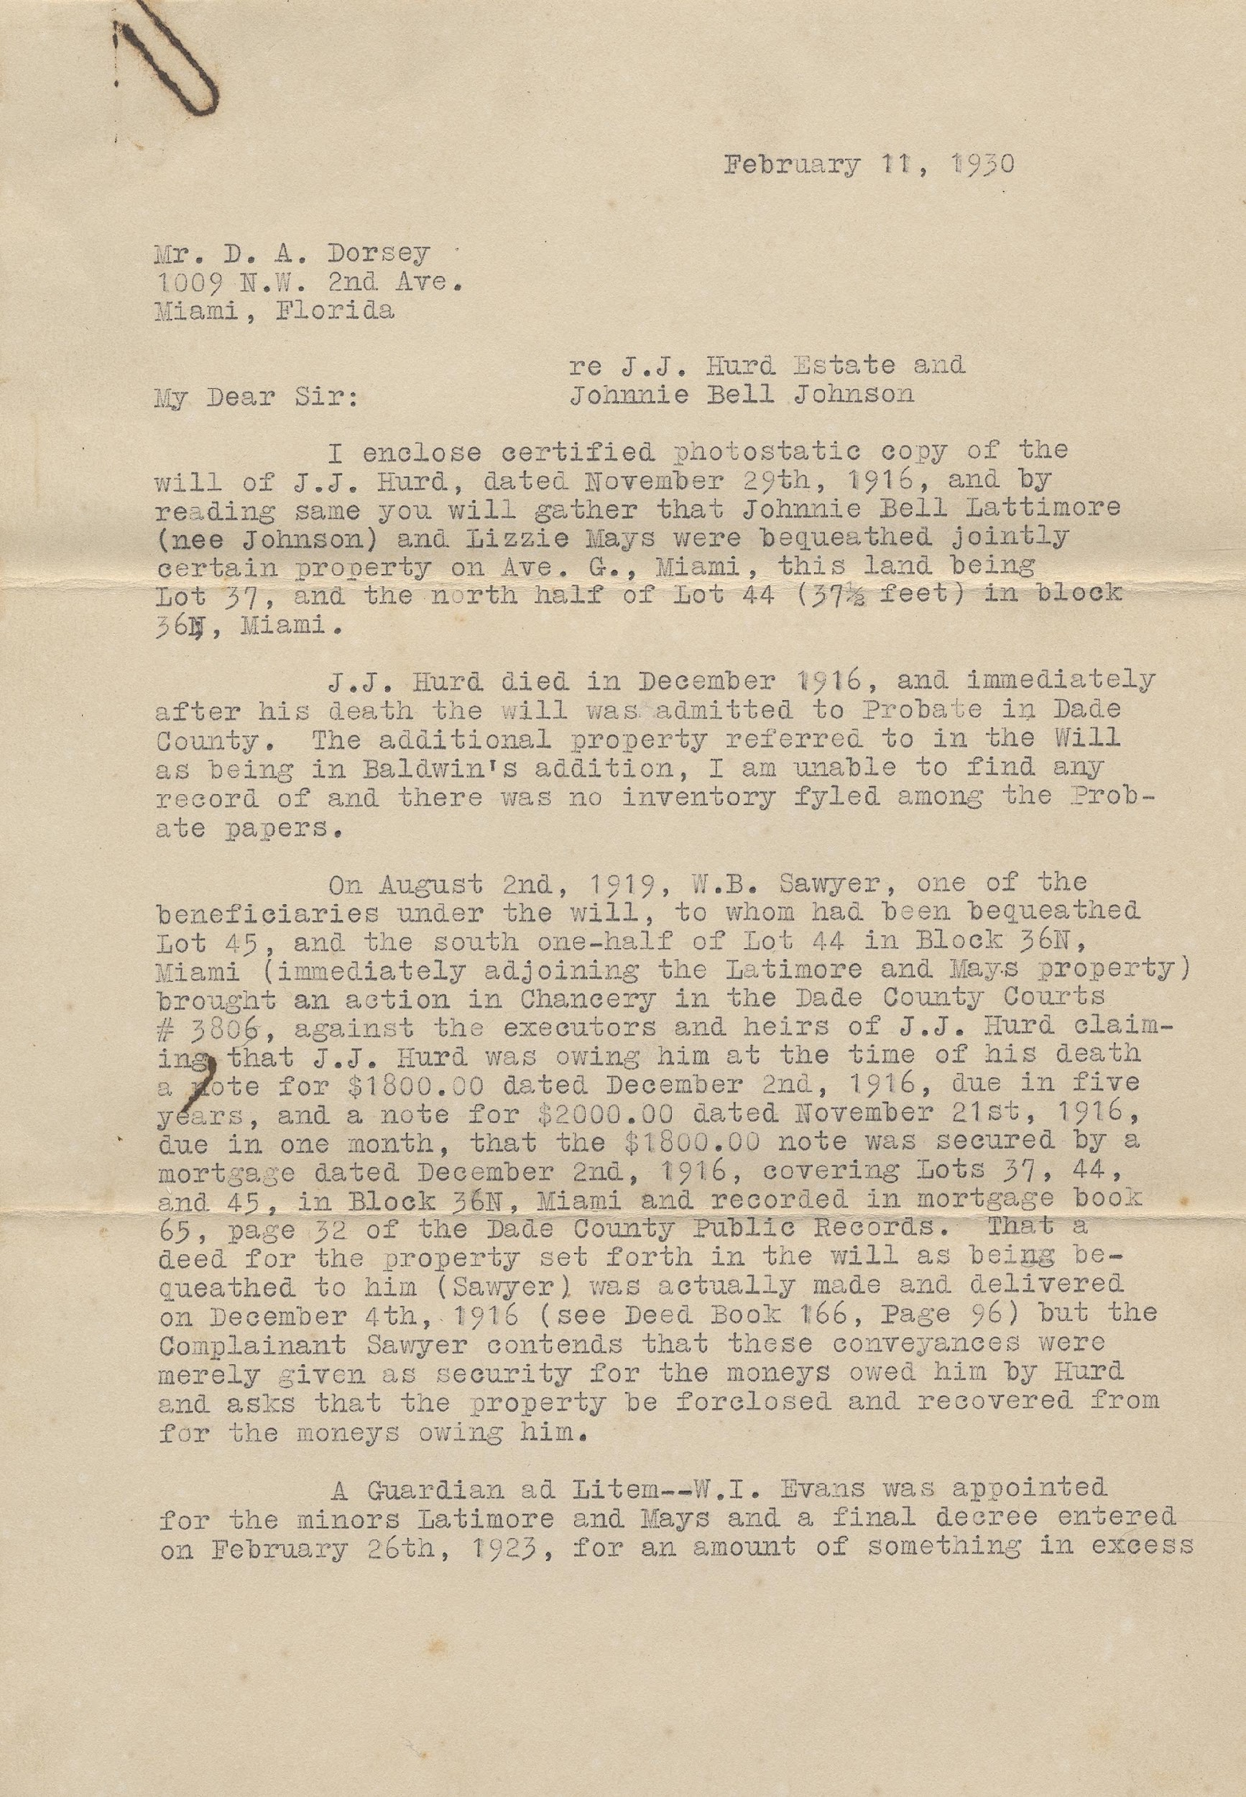
Overview
Dana A. Dorsey: Miami's First Black Millionaire
The Project
Collections as Data & Reparative Archival Practice
Ethical Data Practices
Curating Data from Historical Resources

Slide 3

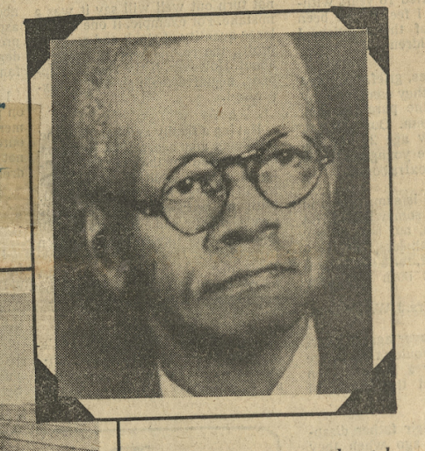
Background
Dana A. Dorsey
The historical data that we are using in the grant focuses on a collection of papers that belonged to Dana A. Dorsey. Dorsey was regarded as Miami’s first Black millionaire, who was known to have amassed wealth through real estate. He moved to Miami in the late 1890’s and lived there until his passing in 1940.
FIU professor emeritus, Dr. Marvin Dunn donated the Dorsey papers to the Florida International University Libraries in 1999. The papers were digitized and made available online in 2003. The collection consists of 291 documents which include warranty deeds, mortgages, legal documents, and correspondence, detailing the properties and locations of what were the newly created Miami sub-divisions from around 1900 through 1940.

Slide 4
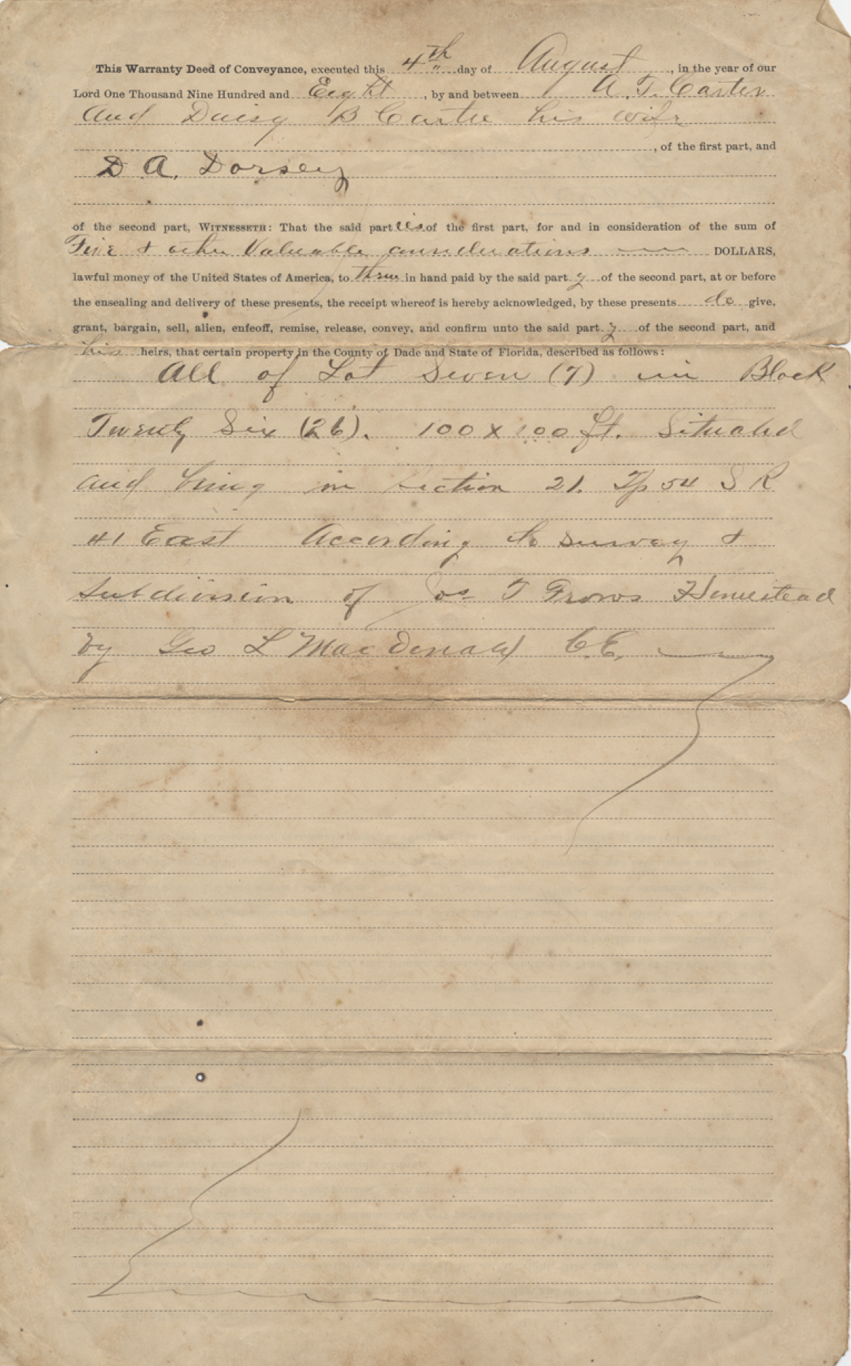
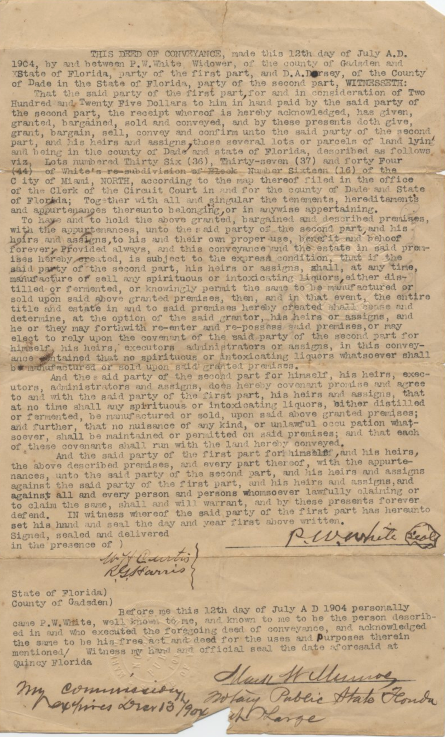
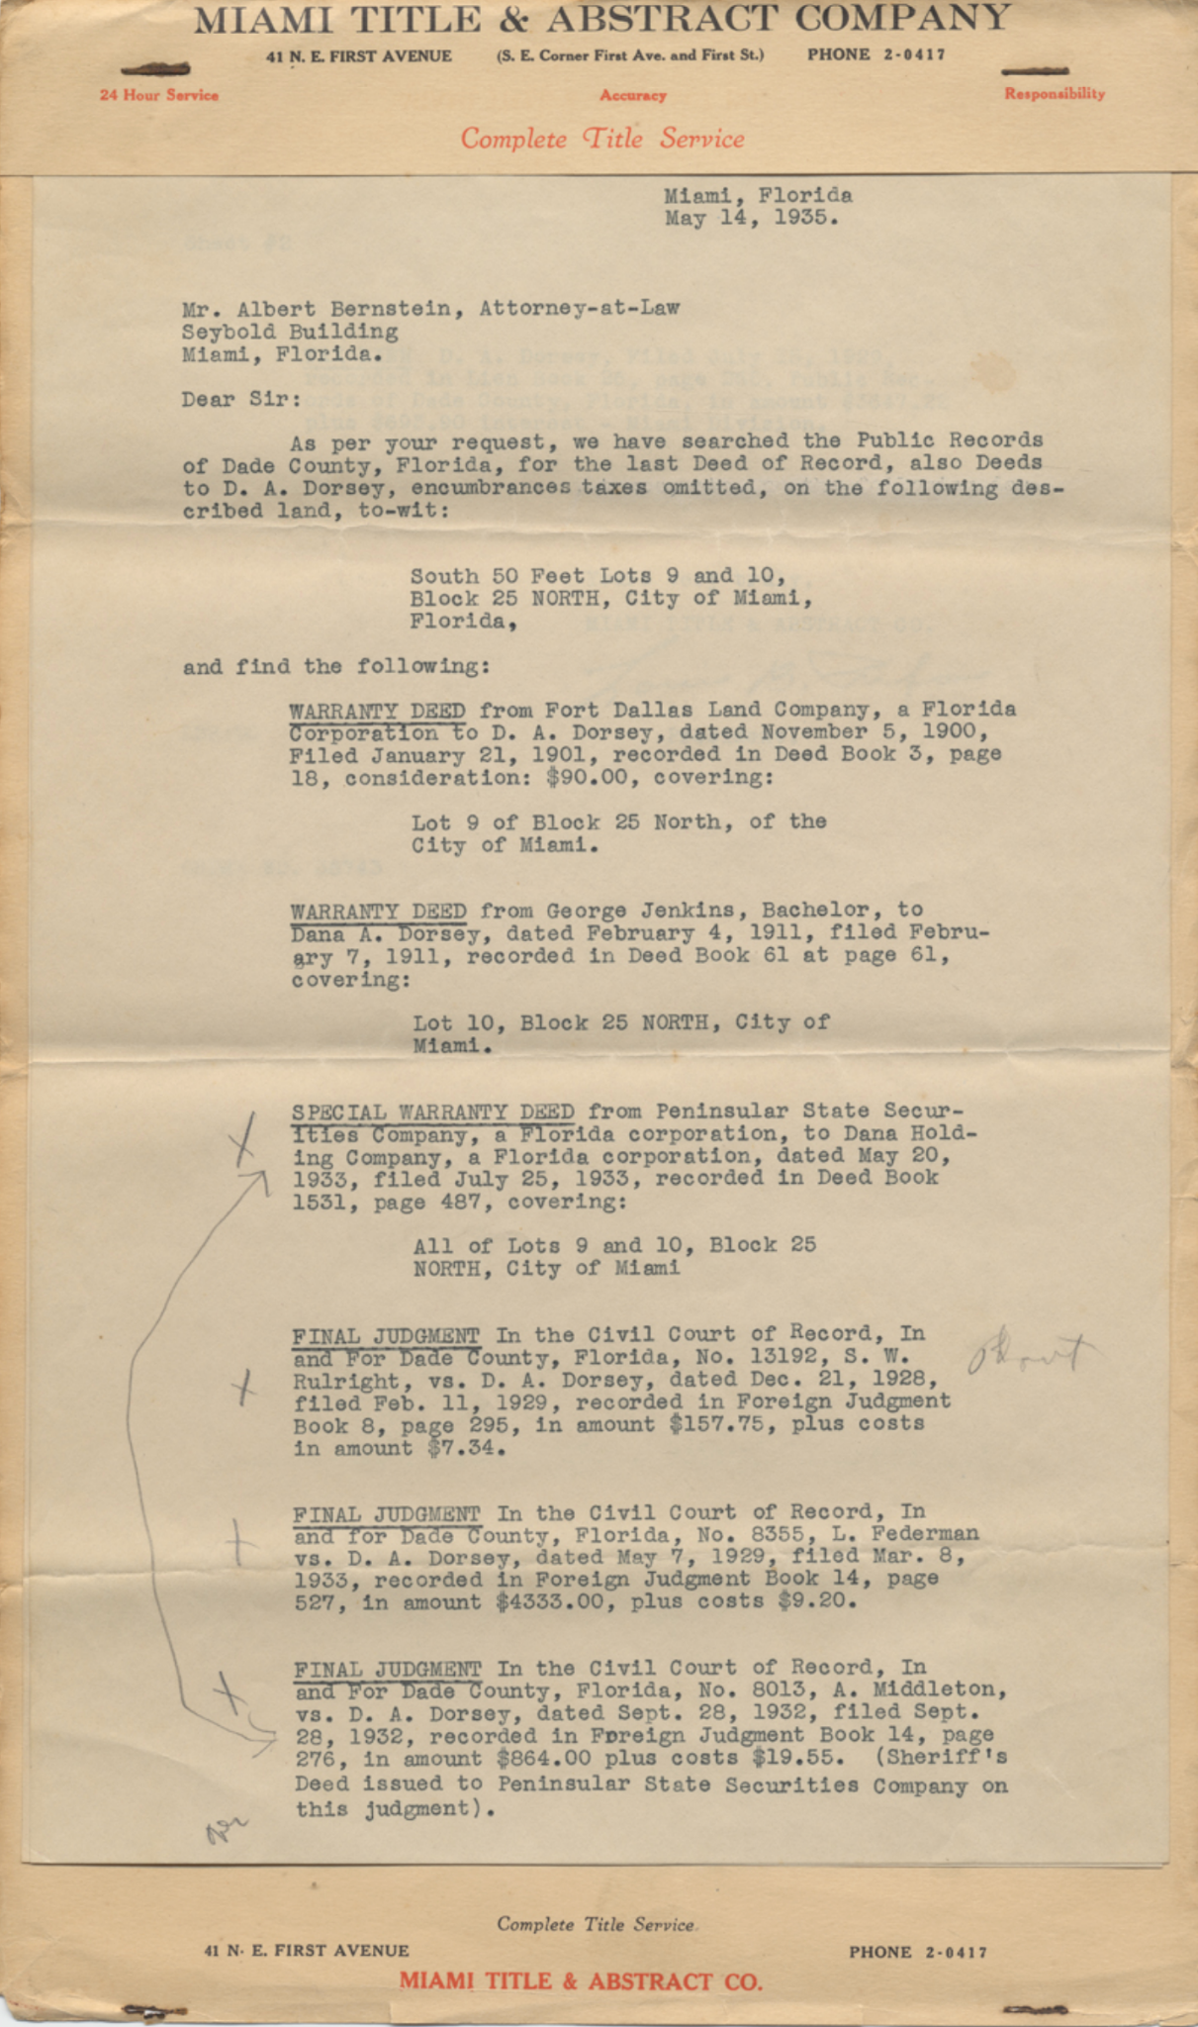

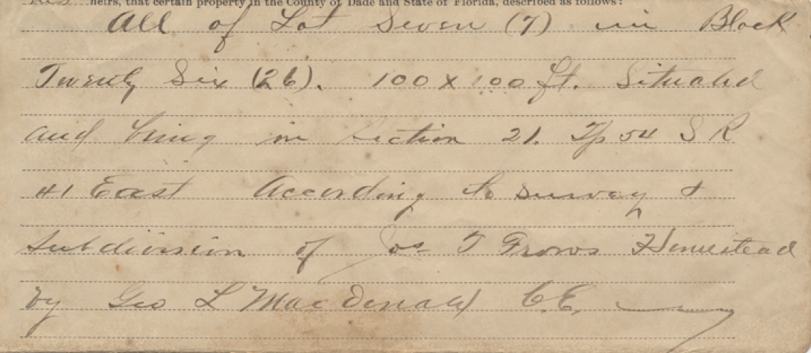
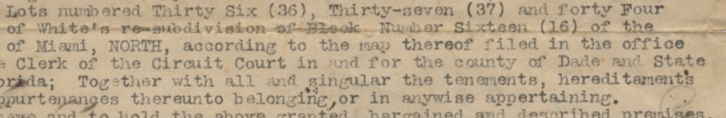
Dana A. Dorsey Papers
Warranty deeds, mortgages, legal documents
Because the documents contained location information referenced in multiple ways, no systematic method had been determined to access the data.

Slide 5
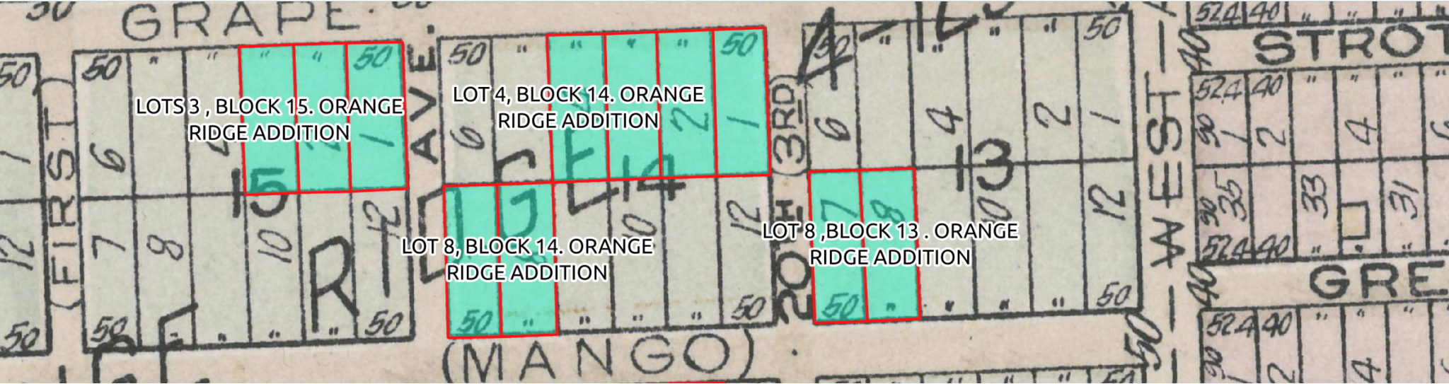
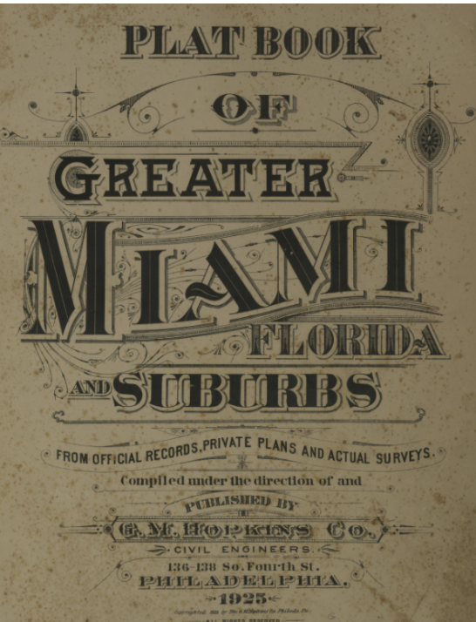
In the fall of 2020, Dr. Levente Juhasz from the FIU Geographic Information Systems (GIS) Center devised a way to use scanned plat map sheets from the Hopkins’ 1925 Plat Map of Greater Miami in our collection to georeference the properties which led to the geolocation of 30 properties from the Dorsey documents.
Building on this success, we applied for and were awarded a NEH grant in 2022.

Slide 6

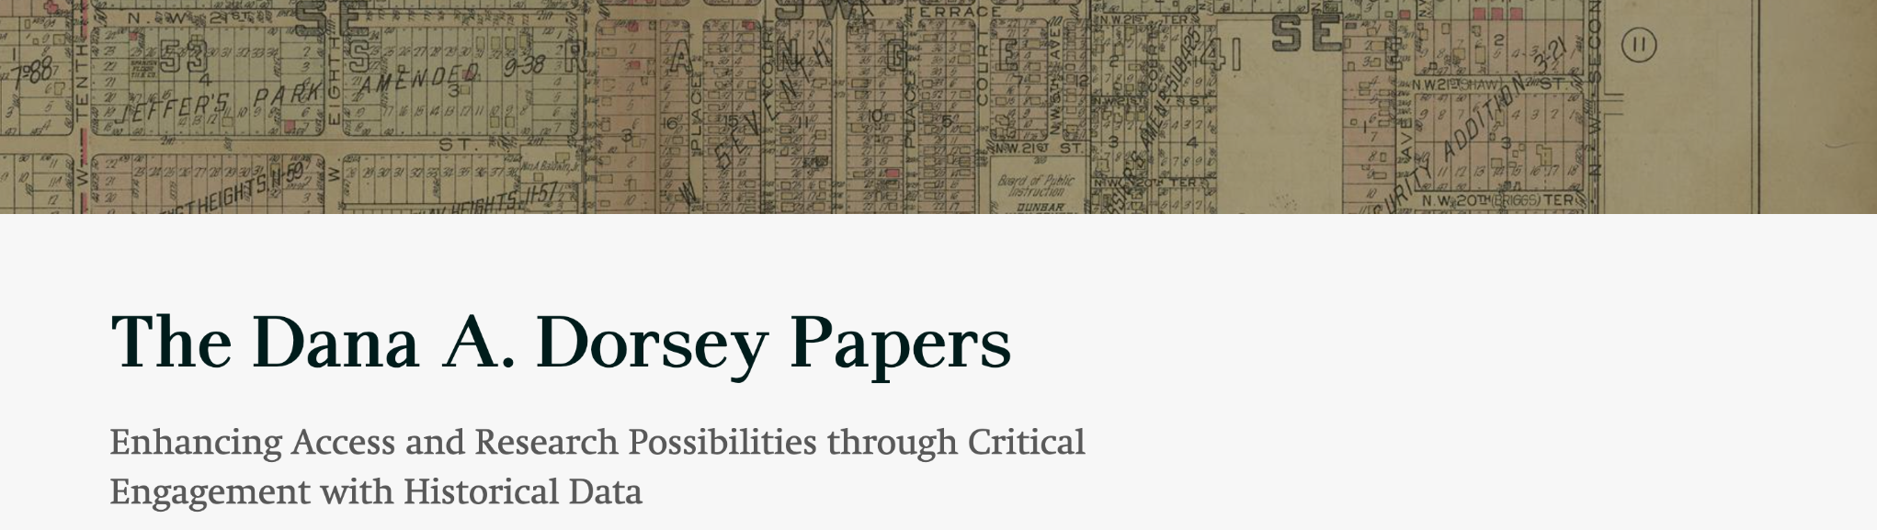
National Endowment for the Humanities
Humanities Collections and Reference Resources
transcripts of the papers
tabular data
georeferenced locations
maps
a consultant report
workshops
presentations
a white paper
go.fiu.edu/dorsey

Slide 7
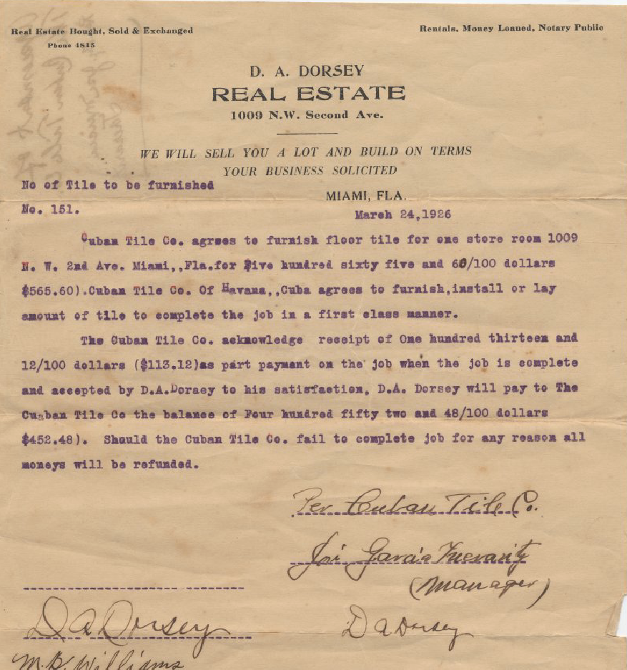
Ethical Practices in Project Planning
Focus on the people involved, their connections, their stories, rather than transactions
Performed environmental scans, literature reviews, similar projects, and brought in historians who focus on Black history
We asked, “Who else can we involve?”
Utilized our growing network to form an advisory board
Made plans for continuous outreach
Developed a project methodology for transparency, feedback, and iterative work

Slide 8
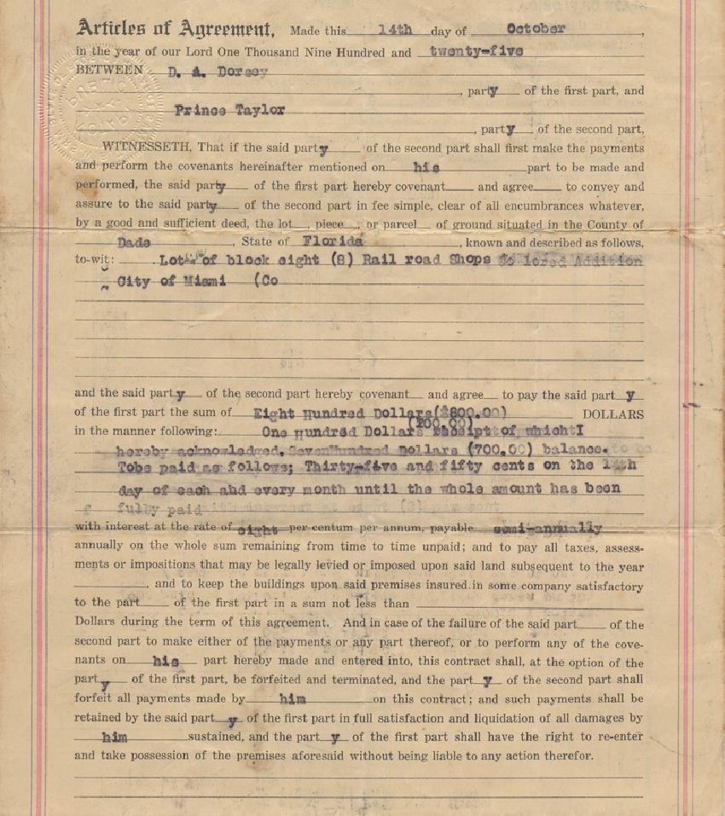
Stakeholders
Communities represented in the collection
Individuals represented in the collection
Advisory board & consultant
Historians, Librarians, Archivists
University and library
Donor
Dorsey family

Slide 9
Curating Data from Historical Resources
Access Considerations
Processes for:
Unstructured data
Structured data
Geospatial data
Technical insights and tools used
Ethical considerations
​
Ensuring equitable access to the derived data by:
creating full-text transcripts of handwritten text
providing various methods for download of the data
utilizing file size chunks that do not limit download on a variety of bandwidths
protecting privacy

Slide 10
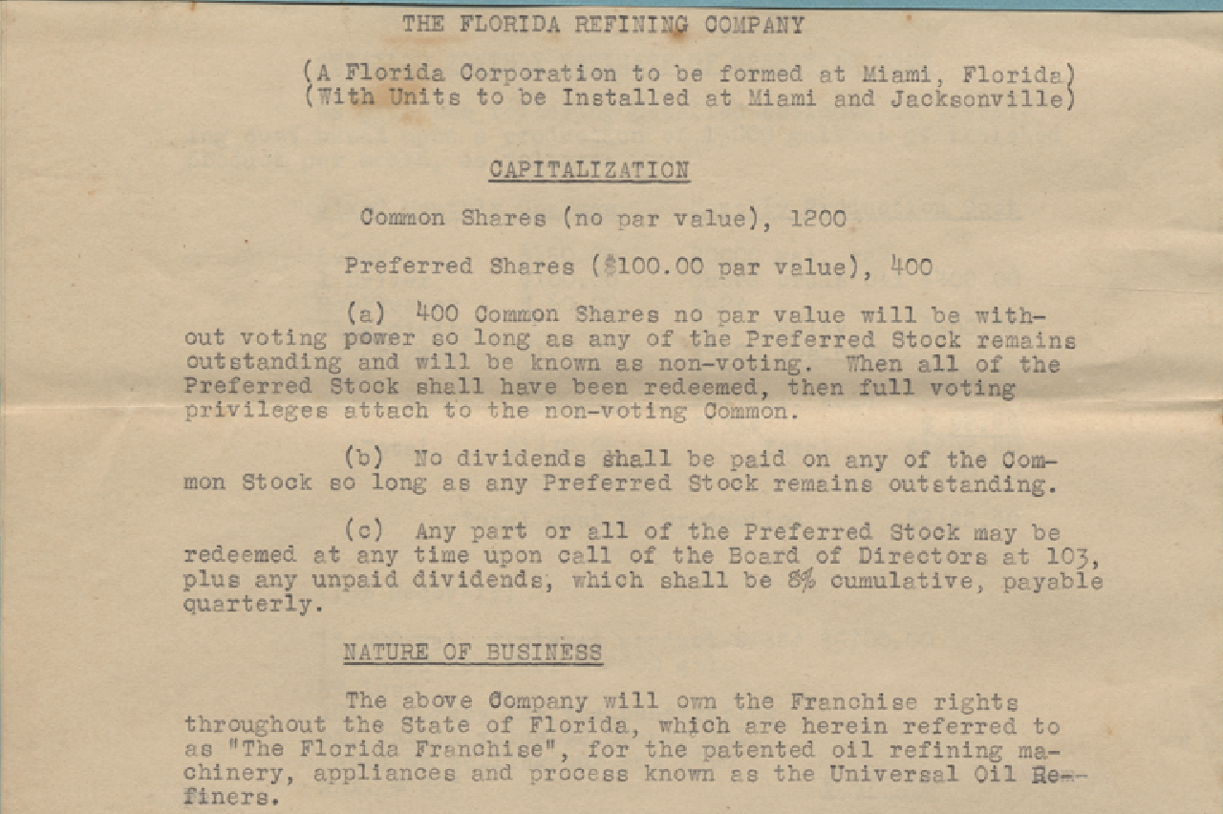
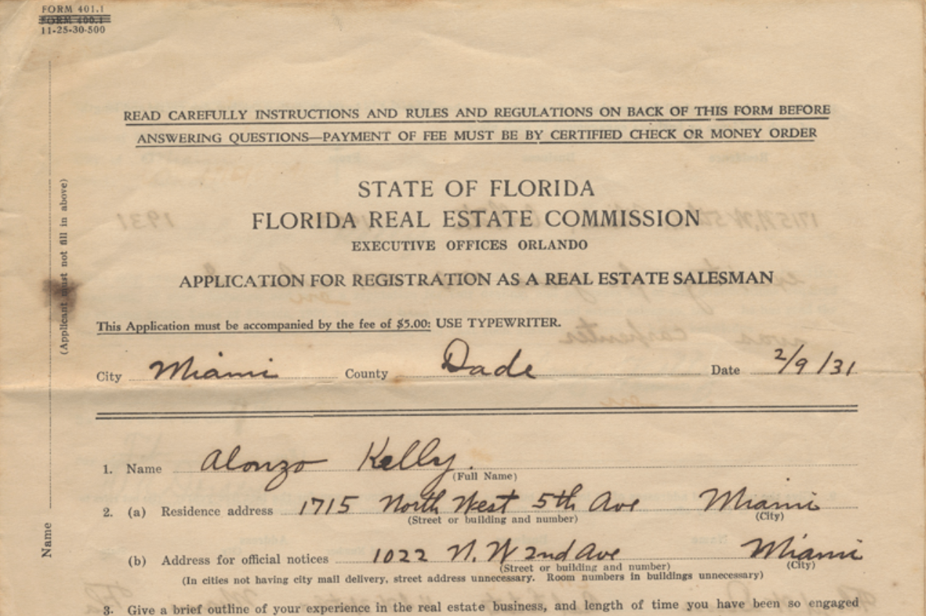
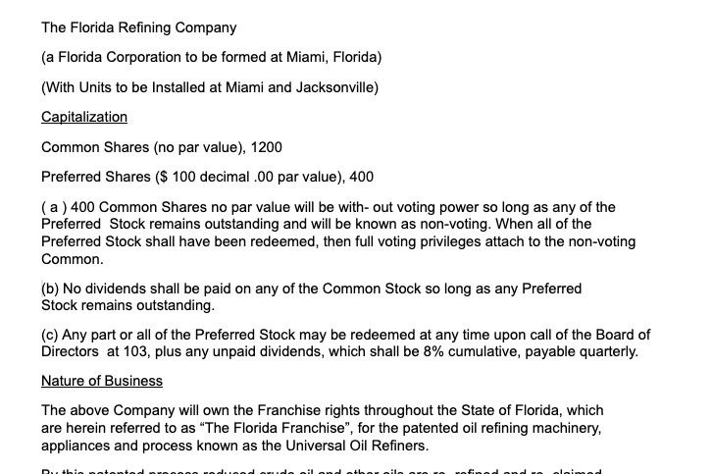
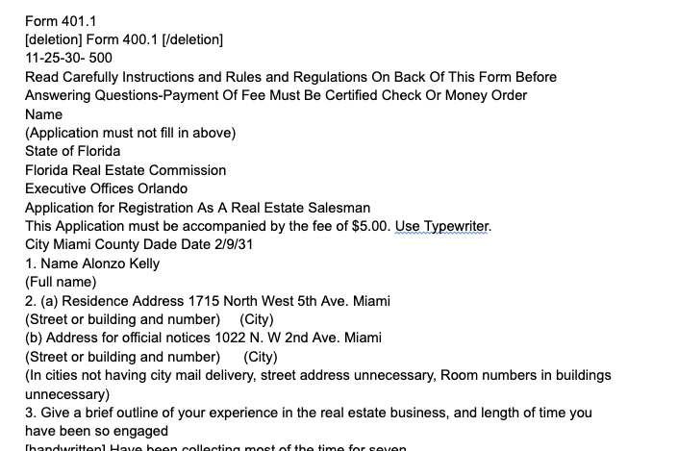
Unstructured Data
Methods
Speech-to-text software with manual QC and edits
How we will make available
In the digital library system along with the PDF page images
In the data repository as downloadable TXT files
The metadata in each system will reference the other

Slide 11
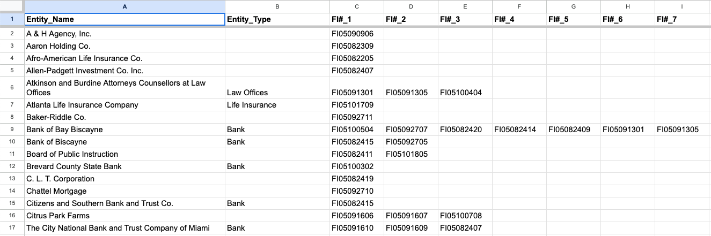
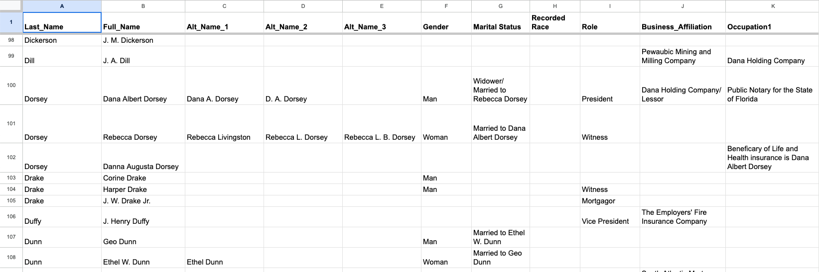
Structured Data
Methods
Manual addition to Google spreadsheet, with QC
How we will make available
In data repository as downloadable CSV files
May also include on website table lookup

Slide 12
Data Selection
Is this information useful for gaining historical insights?
Does it adhere to the mission and values of this project?
Does this information violate personal privacy?
Are we presenting this information in a way that conflicts with cultural values/norms of the group(s) represented?
How can we ensure transparency of our data selection and recording practices?

Slide 13
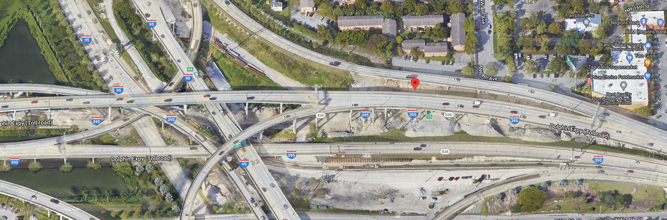
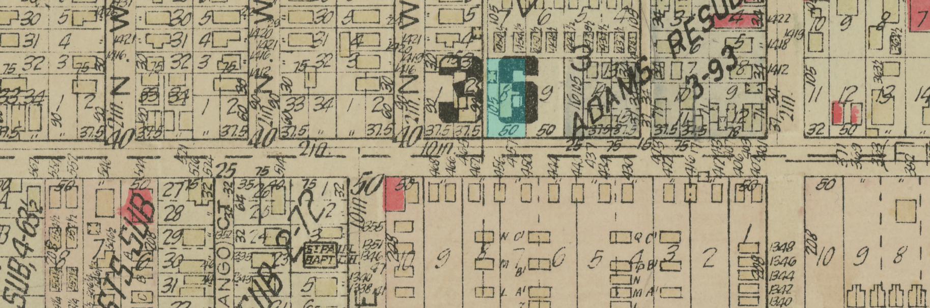
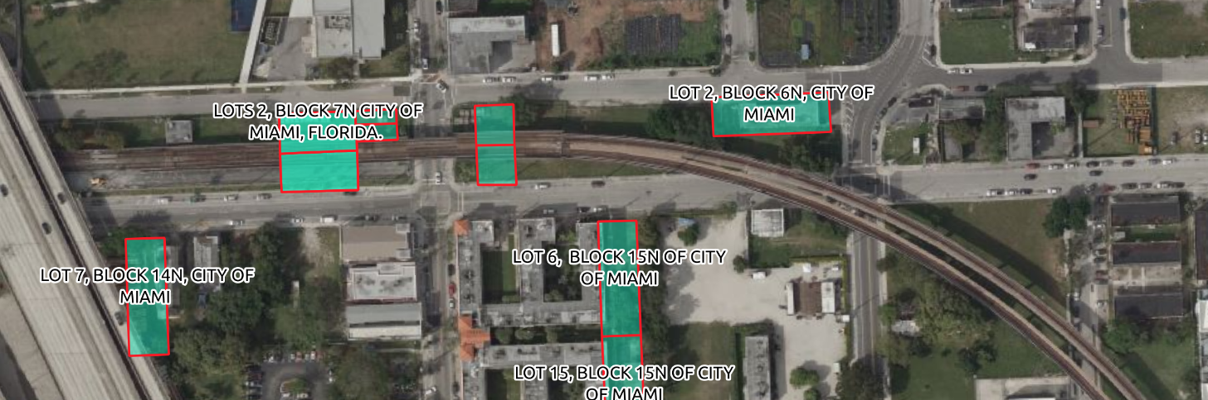
Geospatial Data
Methods
Georectification
Geolocation
How we will make available
Online ArcGIS interface
https://storymaps.arcgis.com/stories/cfc11fa257cb411cba7e3db300c18139

Slide 14
Thank you
Rhia Rae
rrae@fiu.edu
Jamie Rogers
rogersj@fiu.edu

Slide 15
Image References
Slide 1
“Plat Book of Greater Miami, Florida, and Suburbs.” Philadelphia: G.M. Hopkins 1925, http://dpanther.fiu.edu/dpService/dpPurlService/purl/FISC000211/00001
Slide 2
Letter from C. J. Colville to Dana A. Dorsey regarding J. J. Hurd's Estate, 1930 http://dpanther.fiu.edu/dpService/dpPurlService/purl/FI05082311/00001
Slide 3
“Looking Back at Being Black,” Miami Herald. Miami, Fla: Herald Print. and Pub. Co., February 1, 1976.
Slide 4
Abstract of Title. Miami Title and Abstract Co. Dana A. Dorsey, 1935 http://dpanther.fiu.edu/dpService/dpPurlService/purl/FI05101302/00001
Deed of Conveyance between P. W. White and Dana A. Dorsey, 1904 http://dpanther.fiu.edu/dpService/dpPurlService/purl/FI05091309/00001
Warranty Deed of Conveyance between A. J. Carter and Daisy B. Carter, 1908 http://dpanther.fiu.edu/dpService/dpPurlService/purl/FI05110105/00001
Slide 5
“Plat Book of Greater Miami, Florida, and Suburbs.” Philadelphia: G.M. Hopkins 1925, http://dpanther.fiu.edu/dpService/dpPurlService/purl/FISC000211/00001
Slide 6
“Plat Book of Greater Miami, Florida, and Suburbs.” Philadelphia: G.M. Hopkins 1925, http://dpanther.fiu.edu/dpService/dpPurlService/purl/FISC000211/00001
Slide 7
Agreement between Dana A. Dorsey and Cuban Title Co. 1926
http://dpanther.fiu.edu/dpService/dpPurlService/purl/FI05082302/00001
Slide 8
Articles of Agreement between Dana A. Dorsey and Prince Taylor, 1925 http://dpanther.fiu.edu/dpService/dpPurlService/purl/FI05092709/00001
Slide 10
The Florida Refining Company. Articles of Incorporation.
http://dpanther.fiu.edu/dpService/dpPurlService/purl/FI05082203/00001
Application for Registration as a Real Estate Salesman, Alonzo Kelly, 1931
http://dpanther.fiu.edu/dpService/dpPurlService/purl/FI05101002/00001
Slide 13
“Plat Book of Greater Miami, Florida, and Suburbs.” Philadelphia: G.M. Hopkins 1925, http://dpanther.fiu.edu/dpService/dpPurlService/purl/FISC000211/00001
“Reconstructing a Piece of Miami's History” 2021
https://storymaps.arcgis.com/stories/cfc11fa257cb411cba7e3db300c18139
Slide 14
“Plat Book of Greater Miami, Florida, and Suburbs.” Philadelphia: G.M. Hopkins 1925, http://dpanther.fiu.edu/dpService/dpPurlService/purl/FISC000211/00001

