Slide 1
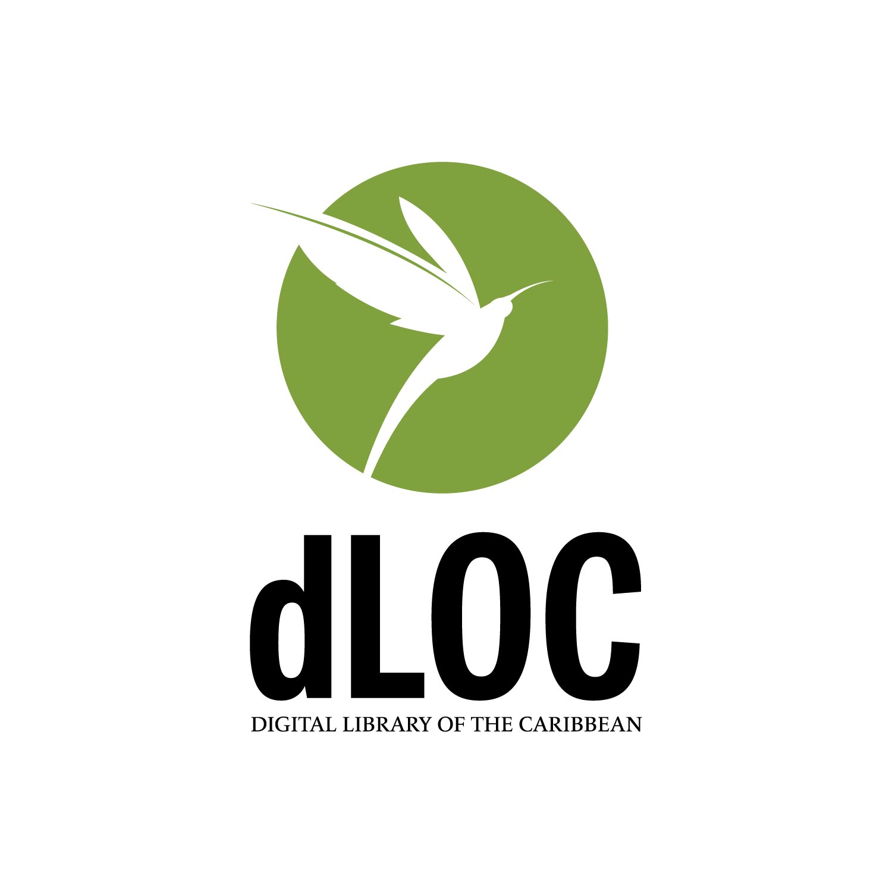
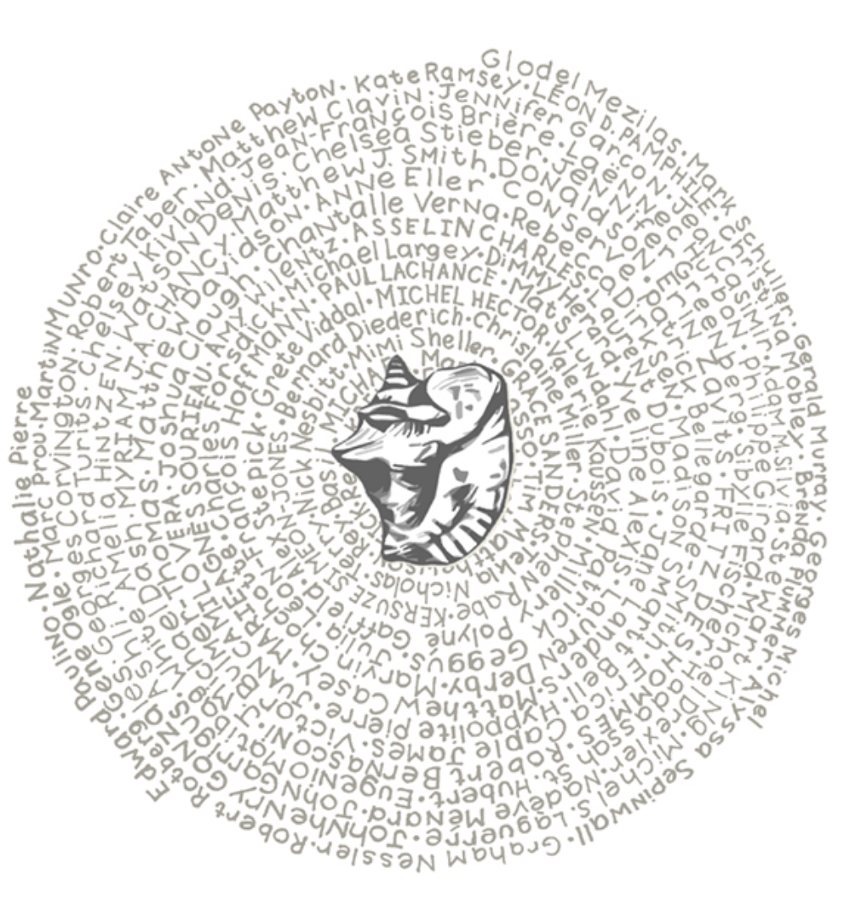
Protecting Haitian Patrimony
Haiti: An Island Luminous
An Island Luminous is a Digital Humanities website to help readers learn about Haiti’s history.
A collaborative effort hosted online by Digital Library of the Caribbean (dLOC), An Island Luminous combines rare books, manuscripts, and photos scanned by archives and libraries in Haiti and the United States with commentary by over 100 experts. It is available in English, Haitian Kreyòl, and French.
Notes:
Haiti: An Island Luminous
An Island Luminous is a site to help readers learn about Haiti’s history. It it tri-lingual available in Kreyol, English, and French
This exhibit shows requires collaboration with libraries, archives, museums, and other communities like scholars, all working together.
Since 2004, Digital Library of the Caribbean has worked with archives and libraries in Haiti to scan and preserve rare books and manuscripts.
Work on An Island Luminous started in 2009. Initially titled “Endepandan Ankò,” the site only covered the years 1934 to 1946.
In 2010, the site expanded to include all of Haiti’s history. It also took its new name, “An Island Luminous,” from a poem, “Calme,” by Haitian intellectual Jacques Roumain.
Since 2010, over 100 authors were invited to write commentary on various historical texts and photos.
Haiti: An Island Luminous features contributions from current scholars and students, excerpts from past publications, and direct links providing free access to books, manuscripts and newspapers, joining expert commentary and original documents to introduce users to 500 years of Haitian history

Slide 2
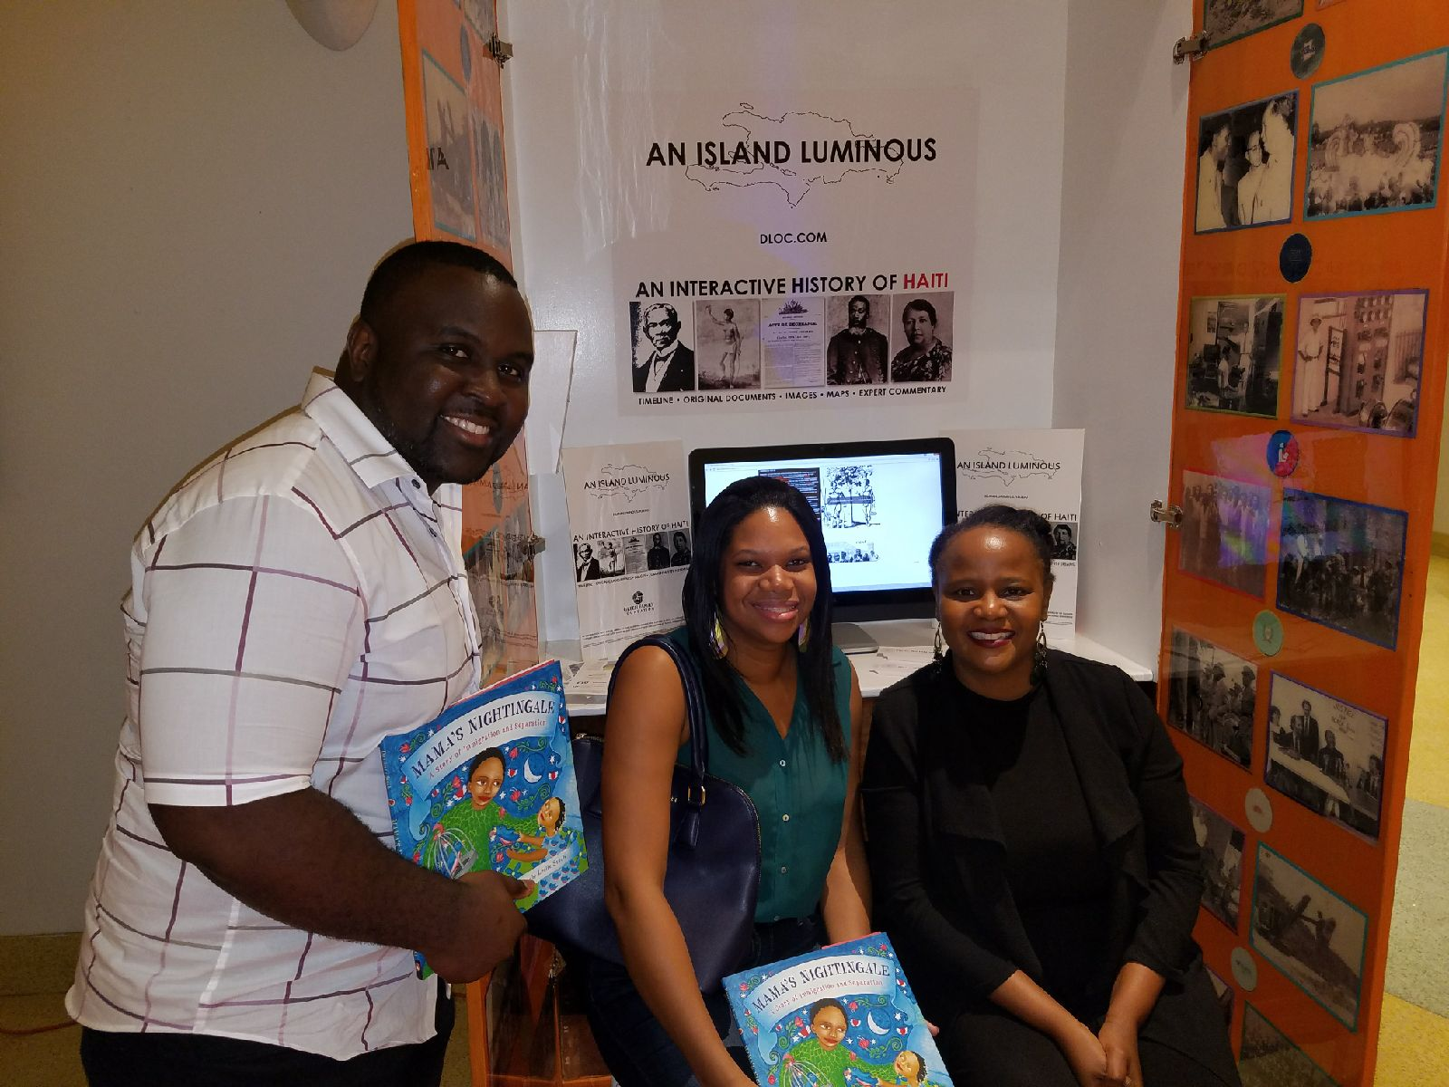
Haiti: An Island Luminous
Exhibit at the
Little Haiti Cultural Complex
Notes:
Since then, we have place another Kiosk at Sant La Haitian Neighborhood Center and have currently placing another at the North Miami Library in May 2019 in time for Haitian Heritage Month.

Slide 3

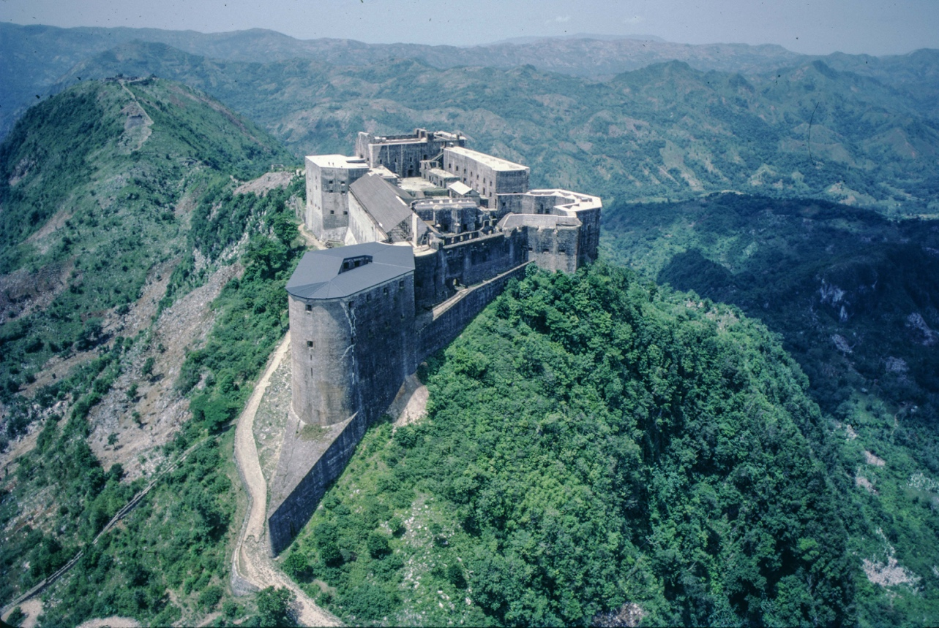
Protecting Haitian Patrimony - ISPAN
The Digital Library of the Caribbean (dLOC) has partnered with Institut de Sauvegarde du Patrimoine National (ISPAN) to protect Haitian national patrimony.
Notes:
The Digital Library of the Caribbean (dLOC) has partnered with Institut de Sauvegarde du Patrimoine National (ISPAN)- - Haitian Institute for the Protection of National Heritage - to protect Haitian national patrimony .Since its creation in 1979, ISPAN, a Haitian government organization, has undertaken numerous research, studies, and investigations that have created extensive documentation on cultural and historical sites throughout Haiti. In addition, ISPAN has carried out important restoration at the Citadelle Henri Christophe, the Palace of Sans-Souci, the Cap-Haïtien Cathedral, Fort Jacques de Fermathe, and the National Palace in Port-au-Prince. In 1994, ISPAN succeeded in obtaining the official title of National Patrimony for thirty-three historical monuments in the city of Cap-Haïtien. ISPAN has limited resources available but is convinced that “Our history is our force,” and seeks to collaborate, within its means, with municipal authorities, associations social and cultural rights, for the promotion and preservation of monuments and historic sites in Haiti. ISPAN seeks to engage students, historians, researchers, journalists, specialists in the construction and planning, (urban planners, architects, engineers, construction workers, etc...), as well as tourist operators who will find valuable and accurate data retained at the institute. ISPAN’s Citadelle and Sans Souci Archives face a monumental challenge in modernizing, preserving, and enhancing accessibility to its archives of photographs, records, and documents.

