Slide 1
The Muted Group Video Project…
Muted Group Theory: What is it? In what ways does it offer a productive guide for community-based work? How can we apply Muted Group Theory to our local context at FIU, one of the nation’s largest Hispanic-Serving Institutions?
The Muted Group Video Project: What is it? How did I implement it pedagogically? What small in-class activities did I use to lead to the larger project? What challenges did I face?
Goal of sharing this project: Help other Humanities faculty envision ways in which they might adopt a similar project to empower their students and engage with local communities.
Student instructions: We are going to put this strategy in action by creating brief videos. Specifically, you are going to work in small groups to create video messages for a group of 3rd graders at a school in Lake Worth, Florida. The majority of these students are immigrants or part of immigrant families. As we know, this is a population of people who are often spoken for and/or spoken about in the mainstream media – and the rhetoric used in these situations is often degrading and harmful. The purpose of these videos is to use your voice as college students at a Hispanic Serving Institution to help these students hear a different message about identity, culture, and/or immigration.

Slide 2
Meet our community partner…
South Grade Elementary School (Title 1, low-income school in Lake Worth, FL)
Ms. Maddox’s 3rd grade class has 22 students: 45% were born in another country
90% are either immigrants themselves or are part of immigrant families
23% are migrants, meaning they move often to work the fields
From Ms. Maddox: ”When they move, they work in the fields too, not just their parents, picking blueberries (the most common one I've heard). This is hard for my students who are often taken out of school in the Spring and do not return until the winter. They miss a lot of school and become very far behind.”
Of the 22 students, only 3 (14%) are native English speakers. For 40% (9 students), Spanish is their first language. One student's first language is Haitian Creole. About 45% of the students speak Mayan dialects from Guatemala.
From Ms. Maddox: “These Mayan dialects make the transition to America especially hard because there are so few other people who speak the same language. They have a hard time in school without any peer support and their families have a hard time navigating life in America.”
Three students came to this country in 2018 and three others came in 2017. The rest came around 2015.

Slide 3
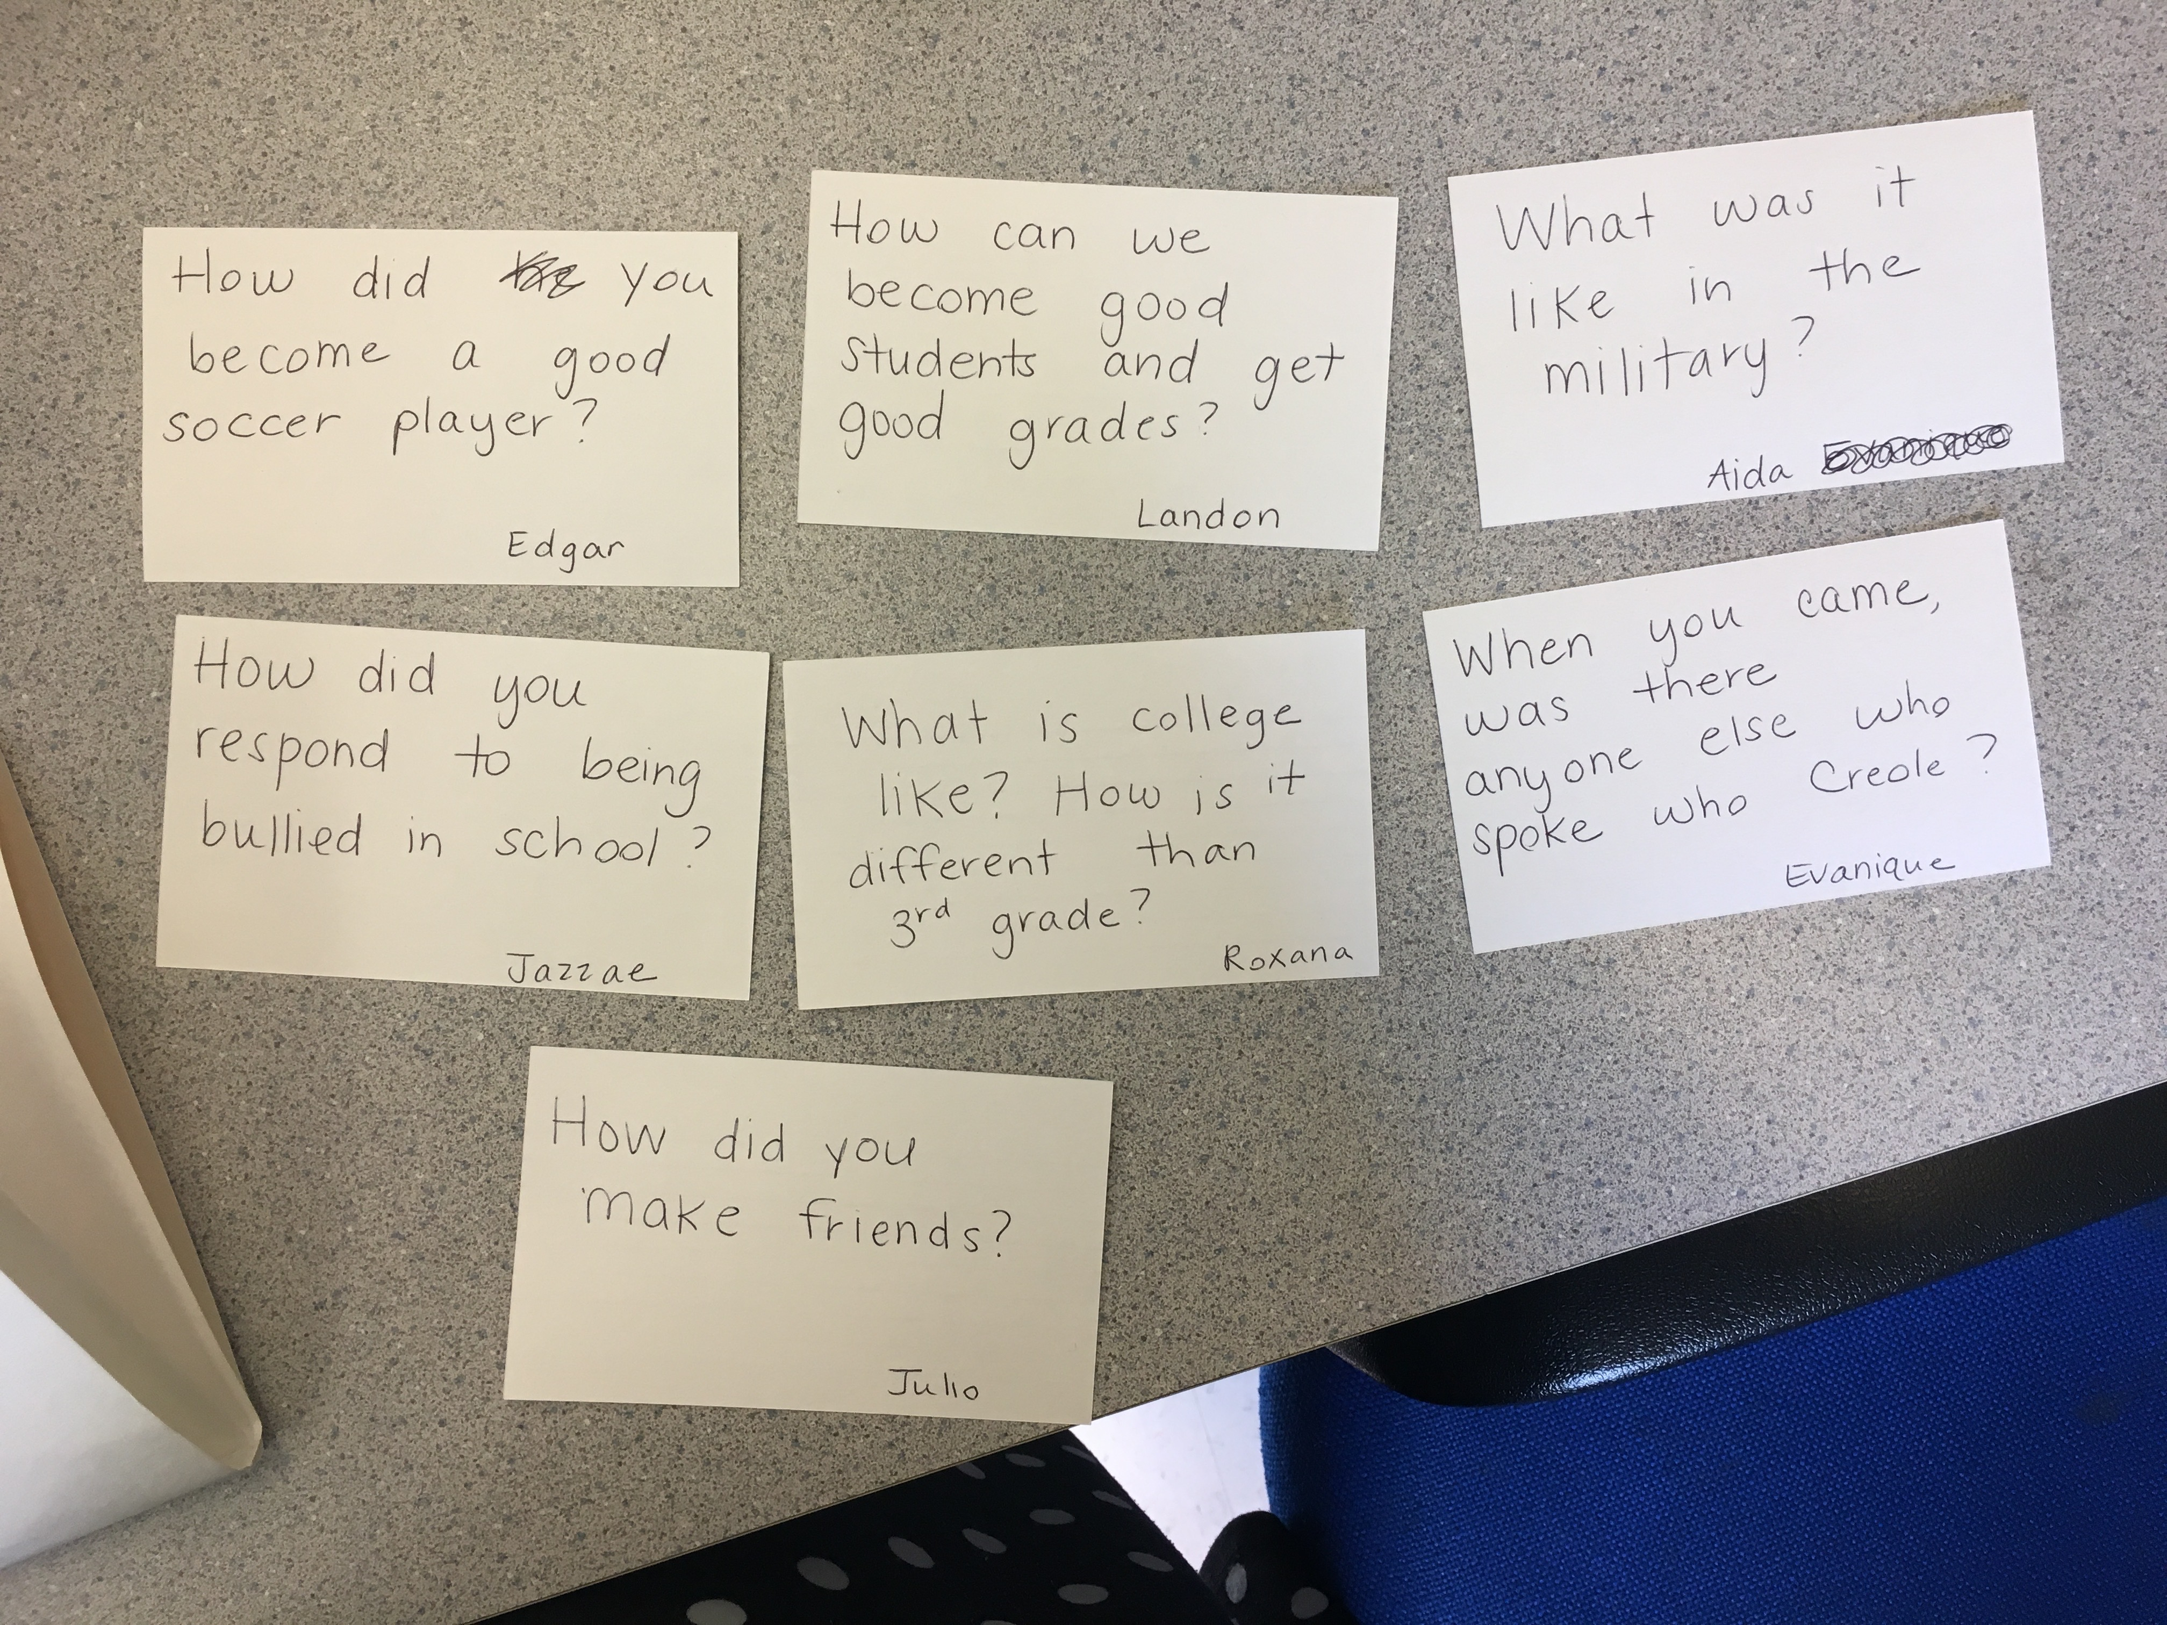
Our final product…
Instructions for FIU students: You are going to work in small groups to create video messages for these students on one of the following themes: embracing multiple cultures, welcoming immigrant students, the importance of school, and college as a goal for the future. We will then compile our small group videos into a larger video to share with Ms. Maddox’s class.
View our finished video here.
After sharing the video, we had a live video conference call with Ms. Maddox’s class. They sent us these questions ahead of time, and we used them to guide our video discussion:

