Slide 1
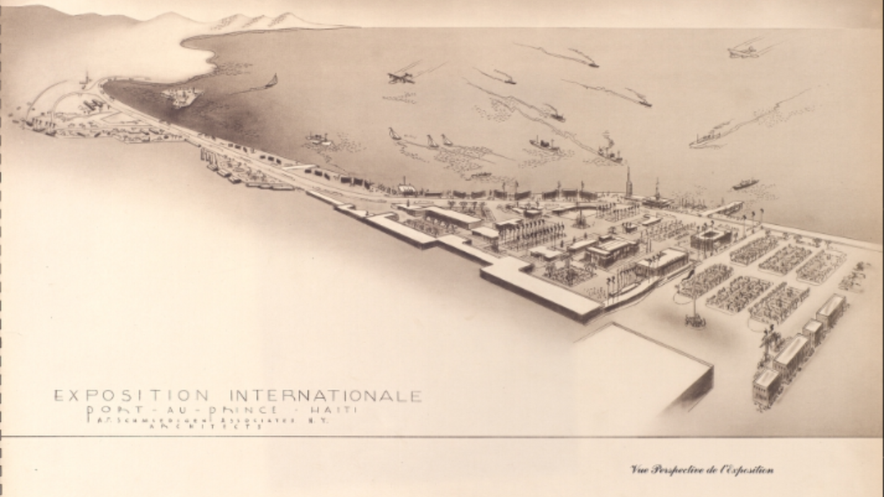
Mapping Fleeting Cities: Haiti’s Bisantne Area

Slide 2
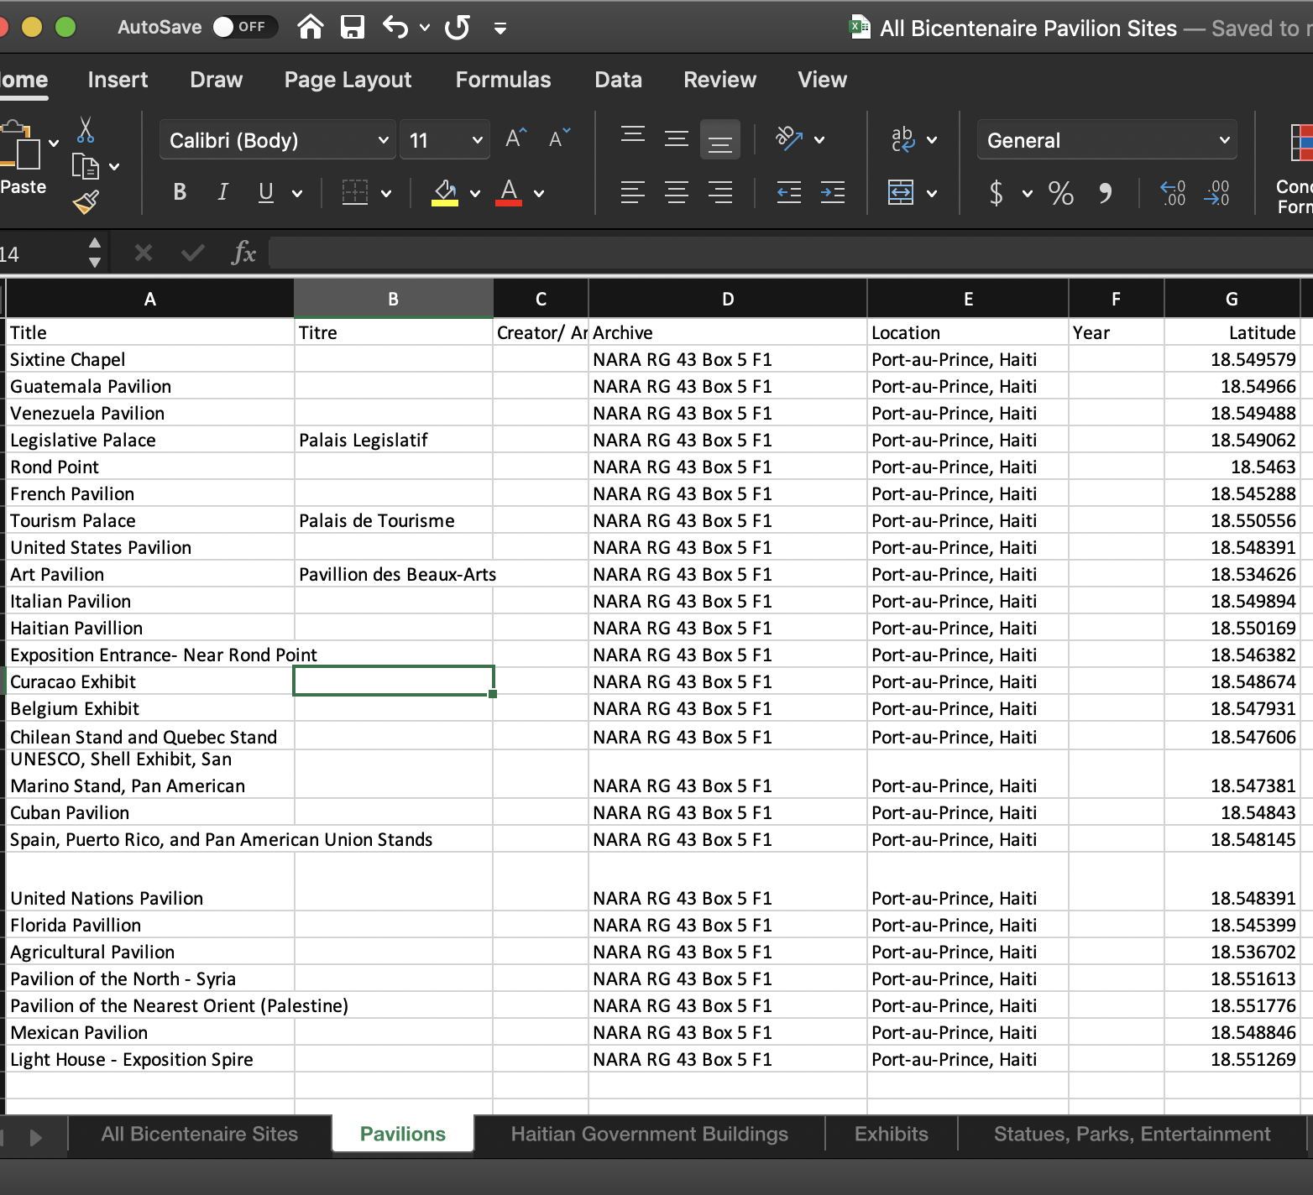
Data Sets

Slide 3
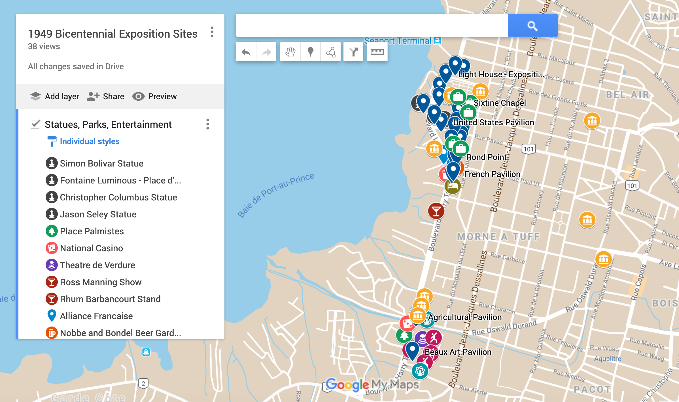
Notes:
ArcGIS StoryMaps - https://storymaps.arcgis.com/stories/20f03020ff4d4e02932e0a8a52075546/edit
Google Maps - https://www.google.com/maps/d/edit?mid=1ZfqTt2Uwk6KXx58dMVJsBl4LYxBg4AaY&ll=18.544065526884005%2C-72.35240516143801&z=15

