Slide 1
URBAN Ruins
And the Neo-Picturesque
“The neo-picturesque is an art practice that uses the medium of landscape to preserve, enhance, and shape environmental memory – memory in the form of experiences of a material past.”

Slide 2
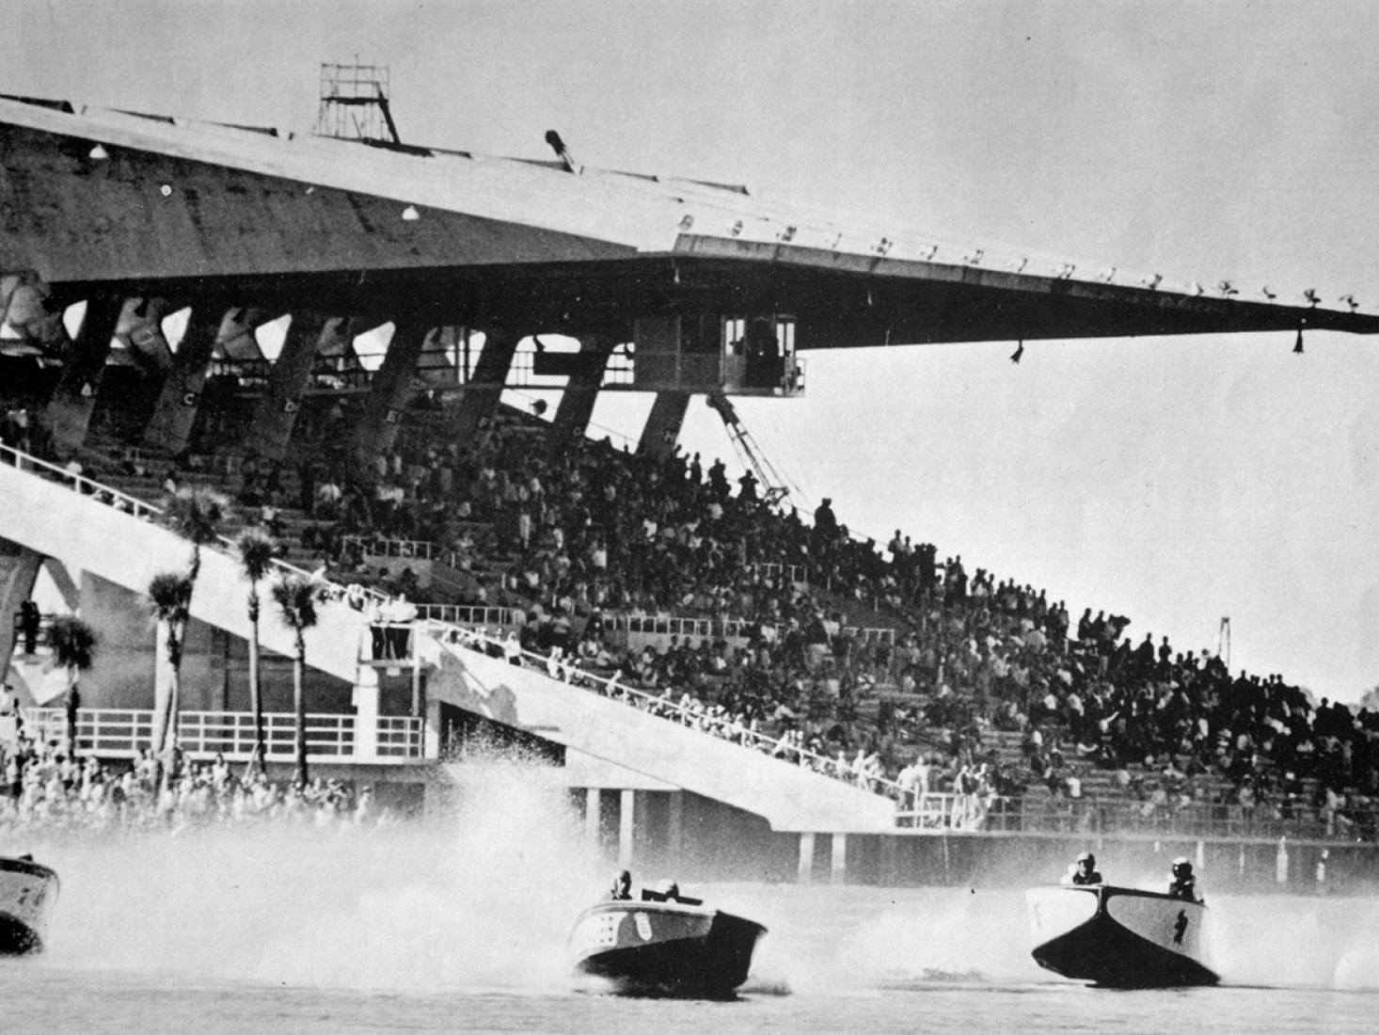

Slide 3
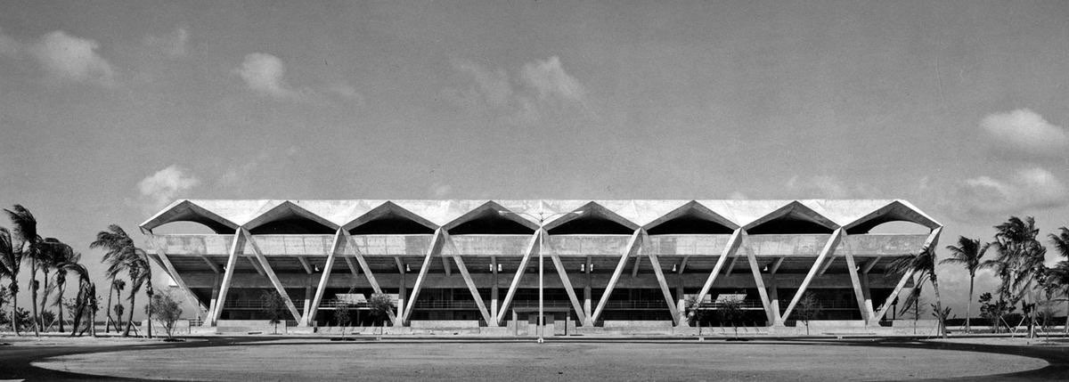
Suggestions for Miami Marine Stadium
Projection on site
Un curated spaces
Multiple uses
Tripartite nature of ruins
Sites of resistance

